Slide 1
The basics of demand and supply

Slide 2
Topic to cover
Demand and Supply
The Demand Curve
The Supply Curve
Market Equilibrium
Surplus
Effects of Government Intervention—Price Controls
Elasticity and revenue

Slide 3
Demand and Supply
Understanding and predicting how changing world economic conditions affect market price and production
Evaluating the impact of government price controls, minimum wages, price supports, and production incentives
Determining how taxes, subsidies, tariffs, and import quotas affect consumers and producers

Slide 4
The Demand curve
Relationship between the quantity of a good that consumers are willing to
buy and the price of the good.
The demand curve is thus a relationship between the quantity demanded
and the price.
We can write this relationship as an equation:
Q_{D} = Q_{D}(P)

Slide 5
The Linear Demand curve
Price ($)
$40
$30
$20
$10
Demand
0
20
40
60
80

Slide 6
Other variables that affect Demand
The quantity that buyers are willing to buy depends not only on the price but also on the following:
Income
Price of the related goods
Substitutes Two goods for which an increase in the price of one leads to an increase in the demand of the other.
Complements Two goods for which an increase in the price of one leads to a decrease in the demand of the other.
Taste and preferences
Change in demand refers to shifts in the demand curve
Change in the quantity demanded refers to movements along the demand curve

Slide 7
Shifting of Demand curve
Price of
clothing
$50
$40
D²
D¹
0
50,000
60,000
Quantity of
clothing

Slide 8
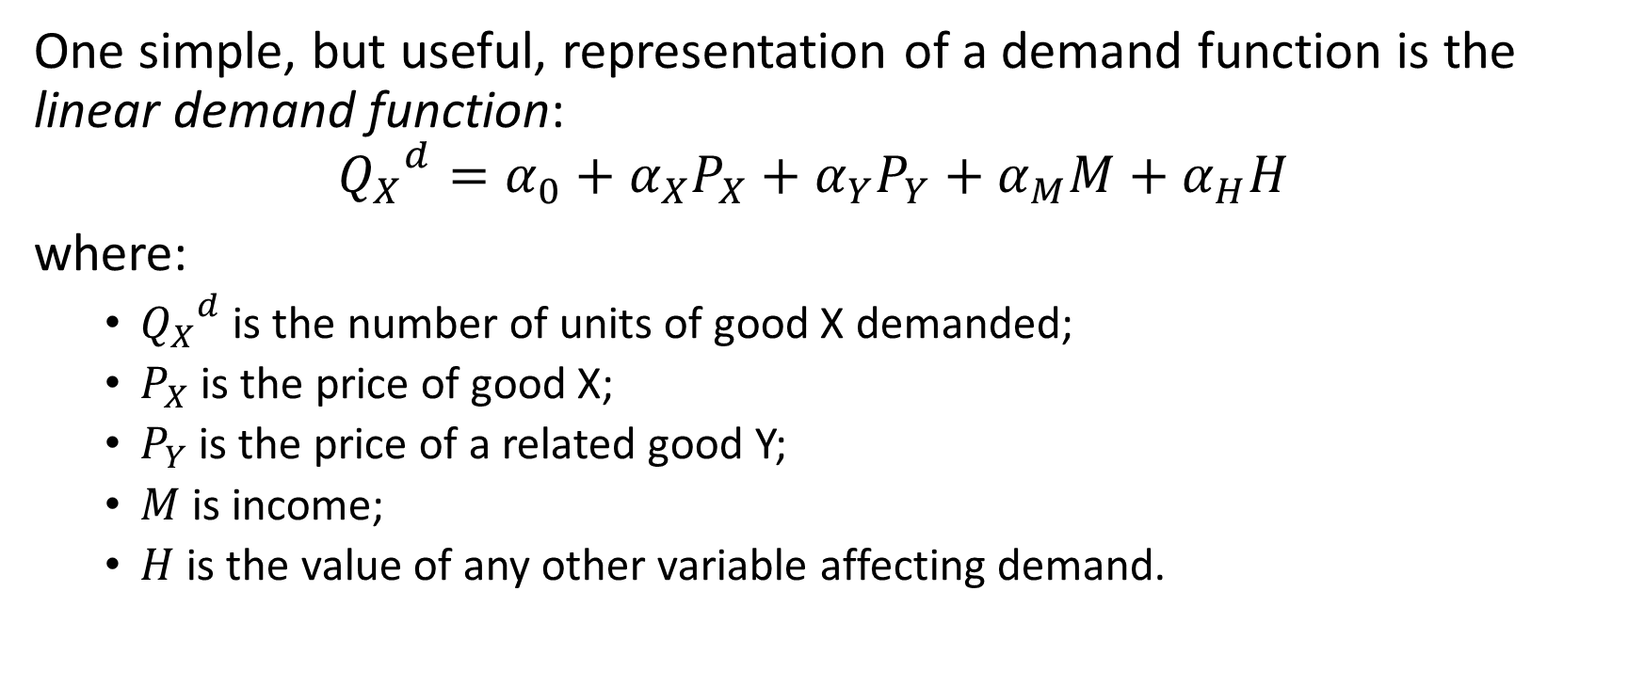
Linear demand function
One simple, but useful, representation of a demand function is the linear demand function:
$${Q_{X}}^{d}=α_{0}+α_{X}P_{X}+α_{Y}P_{Y}+α_{M}M+α_{H}H$$
where:
${Q_{X}}^{d}$ is the number of units of good X demanded;
$P_{X}$ is the price of good X;
$P_{Y}$ is the price of a related good Y;
$M$ is income;
$H$ is the value of any other variable affecting demand.

Slide 9
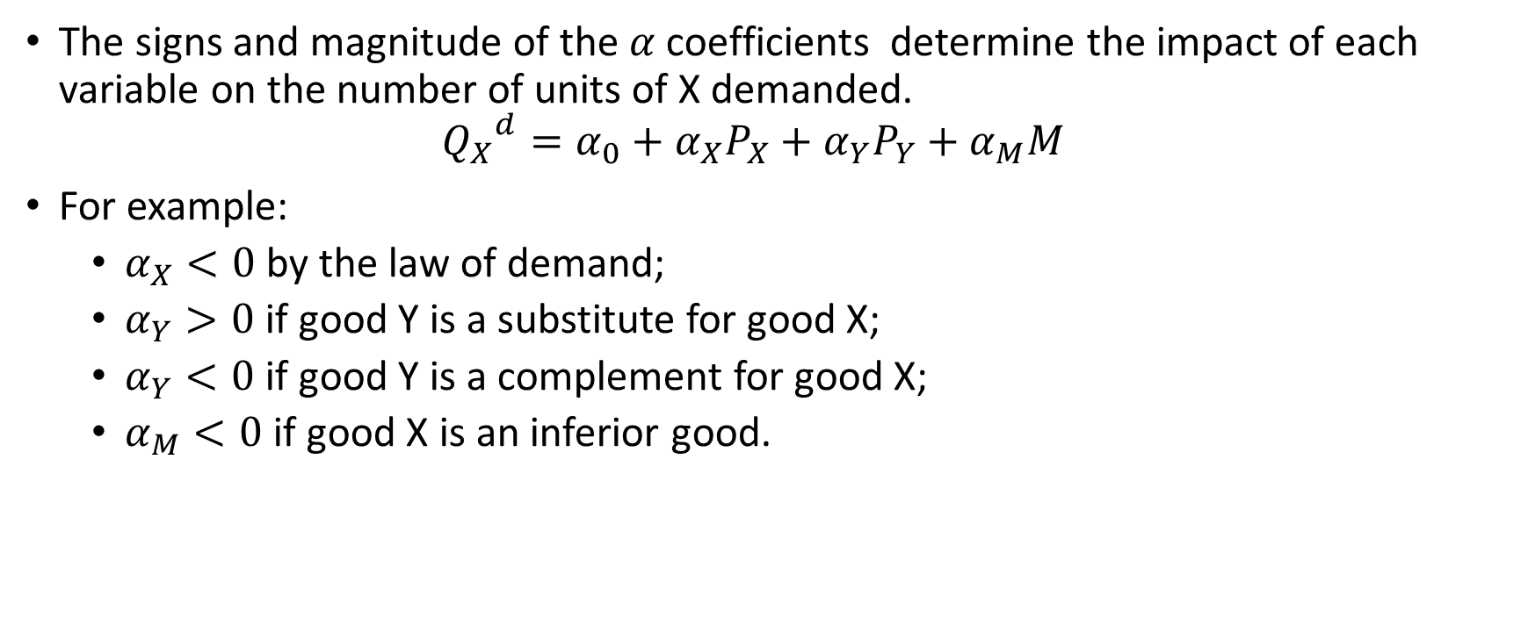
Signs of coefficients of linear demand function
The signs and magnitude of the $α$ coefficients determine the impact of each variable on the number of units of X demanded.
$${Q_{X}}^{d}=α_{0}+α_{X}P_{X}+α_{Y}P_{Y}+α_{M}M$$
For example:
$α_{X}<0$ by the law of demand;
$α_{Y}>0$ if good Y is a substitute for good X;
$α_{Y}<0$ if good Y is a complement for good X;
$α_{M}<0$ if good X is an inferior good.

Slide 10
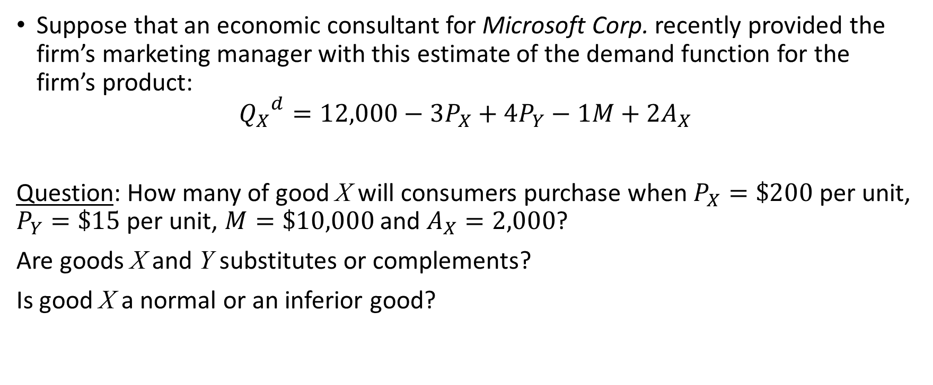
Linear demand function
Suppose that an economic consultant for Microsoft Corp. recently provided the firm’s marketing manager with this estimate of the demand function for the firm’s product:
$${Q_{X}}^{d}=12,000−3P_{X}+4P_{Y}−1M+2A_{X}$$
Question: How many of good X will consumers purchase when $P_{X}=\$200$ per unit, $P_{Y}=\$15$ per unit, $M=\$10,000$ and $A_{X}=2,000$?
Are goods X and Y substitutes or complements?
Is good X a normal or an inferior good?

Slide 11

Linear demand function
Answer:
${Q_{X}}^{d}=12,000−3\left(200\right)+4\left(15\right)−1\left(10,000\right)+2\left(2000\right)=5,460$ units.
Goods X and Y are substitutes.
Good X is an inferior good.

Slide 12
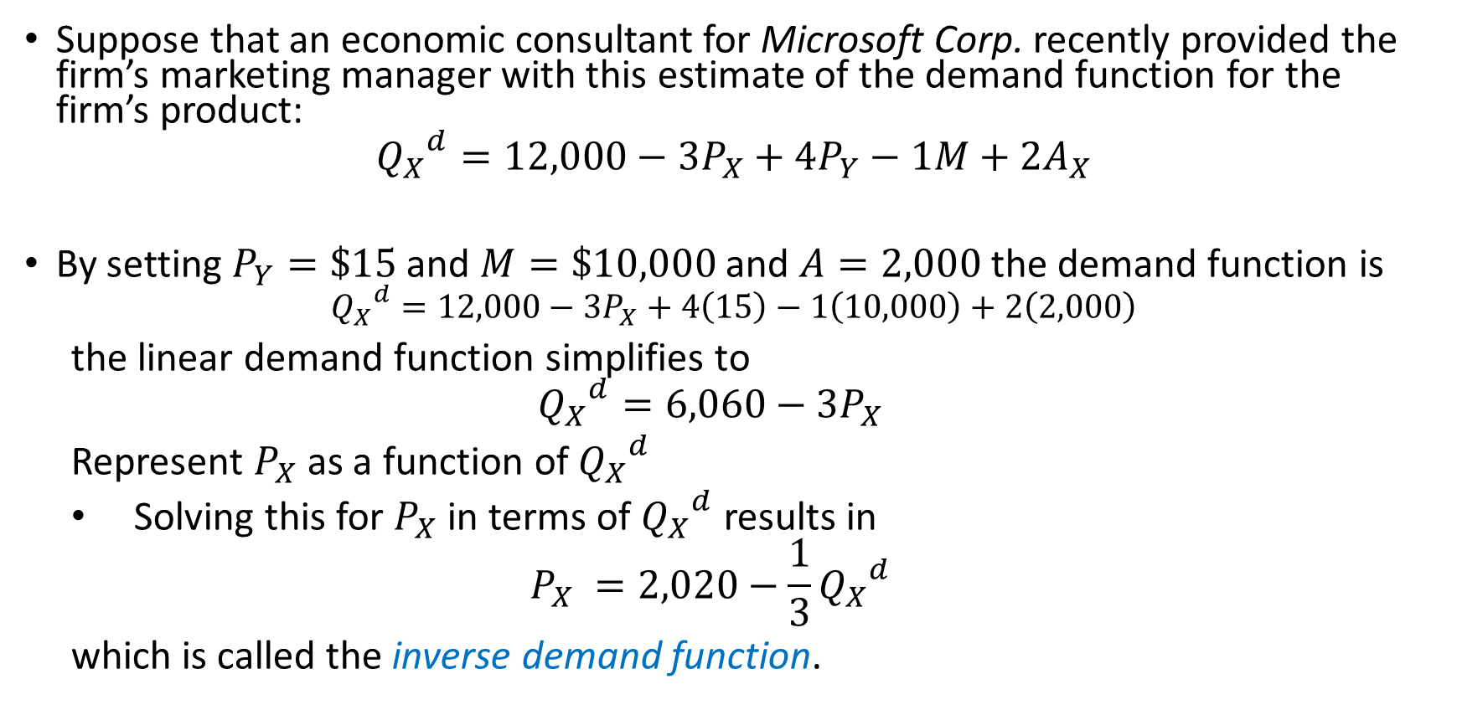
Inverse demand function
Suppose that an economic consultant for Microsoft Corp. recently provided the firm’s marketing manager with this estimate of the demand function for the firm’s product:
$${Q_{X}}^{d}=12,000−3P_{X}+4P_{Y}−1M+2A_{X}$$
By setting $P_{Y}=\$15$ and $M=\$10,000$ and $A=2,000$ the demand function is
$${Q_{X}}^{d}=12,000−3P_{X}+4\left(15\right)−1\left(10,000\right)+2\left(2,000\right)$$
the linear demand function simplifies to
$${Q_{X}}^{d}=6,060−3P_{X}$$
Represent $P_{X}$ as a function of ${Q_{X}}^{d}$
Solving this for $P_{X}$ in terms of ${Q_{X}}^{d}$ results in
$$P_{X} =2,020−\frac{1}{3}{Q_{X}}^{d}$$
which is called the inverse demand function.

Slide 13
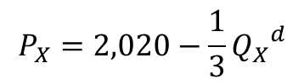
Graph of inverse demand function
Price
$2,020
$$P_{X}=2,020−\frac{1}{3}{Q_{X}}^{d}$$
0
6,060
Quantity

Slide 14
The Supply curve
Relationship between the quantity of a good that producers are willing to
sell and the price of the good.
The supply curve is thus a relationship between the quantity supplied and
the price.
We can write this relationship as an equation:
Q_{S} = Q_{S}(P)

Slide 15
The Linear Supply curve
Price
S⁰
B
P2
A
P1
0
Q1
Q2
Quantity

Slide 16
Other variables that affect Supply
The quantity that producers are willing to sell depends not only on the price they receive but also on their production costs, including wages, interest charges, and the costs of raw materials.
Change in supply refers to shifts in the supply curve
Change in the quantity supplied refers to movements along the supply curve

Slide 17
Shifting of Supply curve
Price
S¹
S⁰
S²
Decrease
in supply
Increase
in supply
Quantity

Slide 18
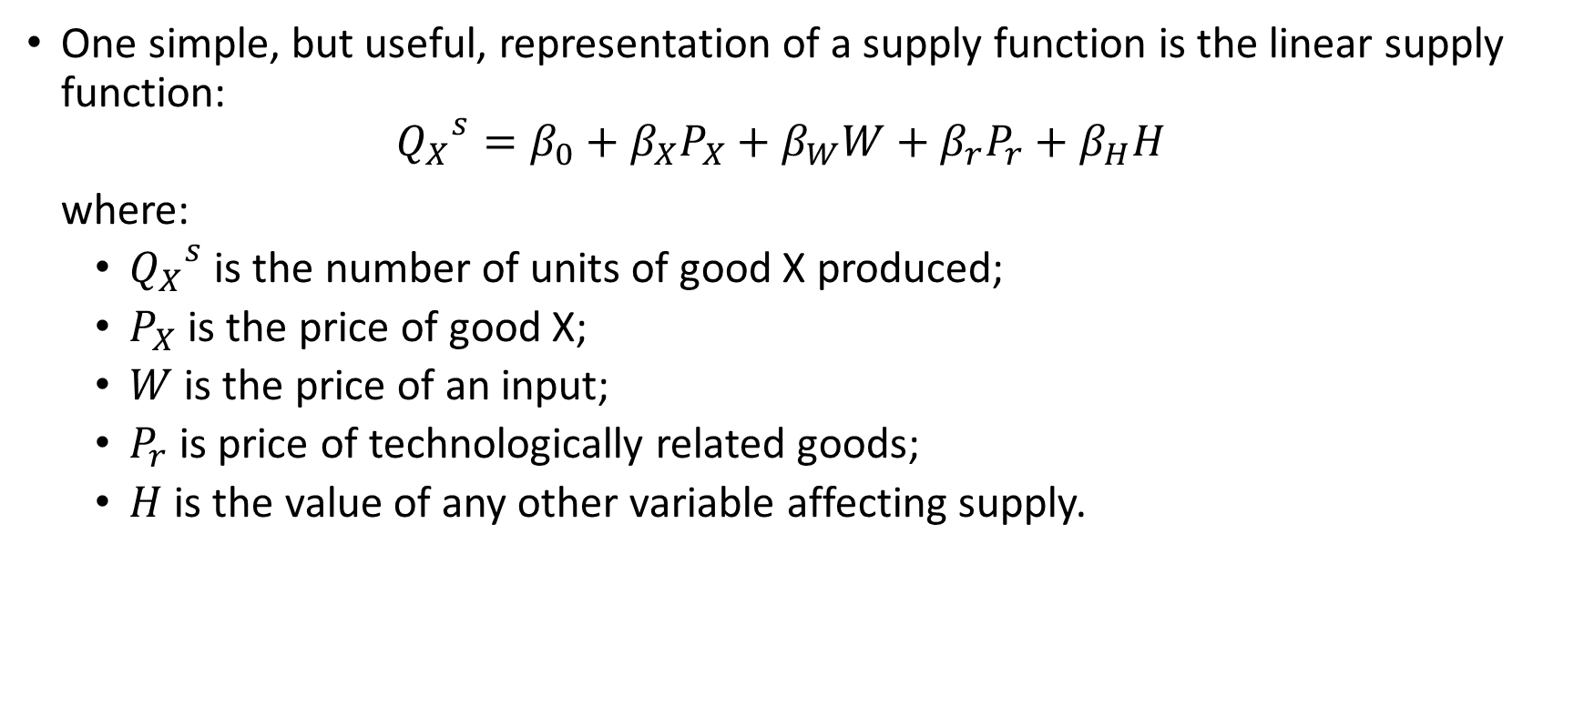
Linear supply function
One simple, but useful, representation of a supply function is the linear supply function:
$${Q_{X}}^{s}=β_{0}+β_{X}P_{X}+β_{W}W+β_{r}P_{r}+β_{H}H$$
where:
${Q_{X}}^{s}$ is the number of units of good X produced;
$P_{X}$ is the price of good X;
$W$ is the price of an input;
$P_{r}$ is price of technologically related goods;
$H$ is the value of any other variable affecting supply.

Slide 19
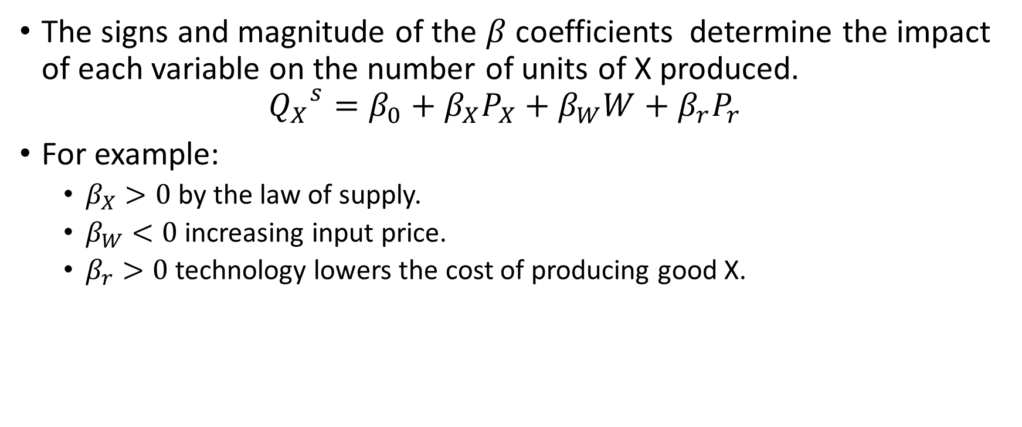
Signs of coefficients of linear supply function
The signs and magnitude of the $β$ coefficients determine the impact of each variable on the number of units of X produced.
$${Q_{X}}^{s}=β_{0}+β_{X}P_{X}+β_{W}W+β_{r}P_{r}$$
For example:
$β_{X}>0$ by the law of supply.
$β_{W}<0$ increasing input price.
$β_{r}>0$ technology lowers the cost of producing good X.

Slide 20

Linear supply function
Your research department estimates that the supply function for televisions sets is given by:
$${Q_{X}}^{s}=2,000+3P_{X}−4P_{R}−1P_{W}$$
Question: How many televisions are produced when $P_{X}=\$400$, $P_{R}=\$100$ per unit, and $P_{W}=\$2,000$?

Slide 21

Linear supply function
Answer:
${Q_{X}}^{s}=2,000+3\left(400\right)−4\left(100\right)−1\left(2,000\right)=800$ television sets.

Slide 22
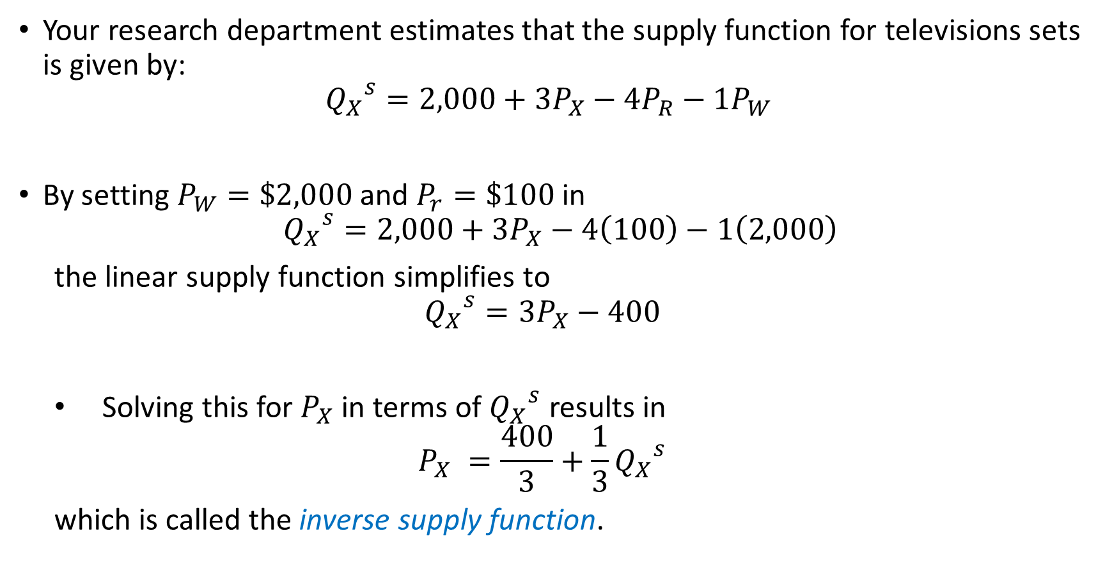
Inverse supply function
Your research department estimates that the supply function for televisions sets is given by:
$${Q_{X}}^{s}=2,000+3P_{X}−4P_{R}−1P_{W}$$
By setting $P_{W}=\$2,000$ and $P_{r}=\$100$in
$${Q_{X}}^{s}=2,000+3P_{X}−4\left(100\right)−1\left(2,000\right)$$
the linear supply function simplifies to
$${Q_{X}}^{s}=3P_{X}−400$$
Solving this for $P_{X}$ in terms of ${Q_{X}}^{s}$ results in
$$P_{X} =\frac{400}{3}+\frac{1}{3}{Q_{X}}^{s}$$
which is called the inverse supply function.

Slide 23
Market equilibrium
Competitive market equilibrium
Price of a good is determined by the interactions of the market demand and market supply for the good.
A price and quantity such that there is no shortage or surplus in the market.
Forces that drive market demand and market supply are balanced, and there is no pressure on prices or quantities to change.

Slide 24






Market equilibrium
Price
Supply
Surplus
$$P^{H}$$
$$P^{e}$$
$$P^{L}$$
Shortage
Demand
0
$$Q^{0}$$
$$Q^{e}$$
$$Q^{1}$$
Quantity

Slide 25

Market equilibrium
Consider a market with demand and supply functions, respectively, as
$Q^{d}=10−2P$ and $Q^{s}=2+2P$
Find the equilibrium price and quantity.

Slide 26

Market equilibrium
A competitive market equilibrium exists at a price, $P^{e}$, such that $Q^{d}\left(P^{e}\right)=Q^{s}\left(P^{e}\right)$.
That is,
$$10−2P=2+2P$$
$$8=4P$$
$$P^{e}=\$2$$
$Q^{e}=10−2\left(\$2\right)=6$ and $Q^{e}=2+2\left(\$2\right)=6$
$Q^{e}=6$ units

Slide 27
Stable and unstable equilibrium
Follow the diagram below where A, B, and C are three equilibriums. Find the stable and unstable equilibriums
P_{x}
S
D
C
B
A
D
S
Q_{x}
O

Slide 28
Consumer surplus
Total consumer value is the sum of the maximum amount a consumer is willing to pay at different quantities.
Total expenditure is the per-unit market price times the number of units consumed.
Consumer surplus is the extra value that consumers derive from a good but do not pay for. Alternatively, the difference between the reservation price and the price consumers actually pay is consumer surplus.

Slide 29
Consumer surplus
Price per
liter
Consumer Surplus:
0.5($5 - $3)x(2-0) = $2
$5
Total Consumer Value:
0.5($5 - $3)x2+(3-0)(2-0) = $8
$4
$3
Expenditures:
$(3-0) x (2-0) = $6
$2
$1
Demand
0
1
2
3
4
5
Quantity
in liters

Slide 30
Producer surplus
The amount producers receive in excess of the amount necessary to induce them to produce the good.

Slide 31

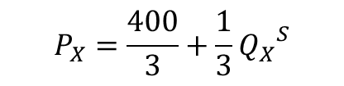
Producer surplus
Price
$$P_{X}=\frac{400}{3}+\frac{1}{3}{Q_{X}}^{S}$$
Supply
$400
Producer surplus
$$\frac{\$400}{3}$$
0
800
Quantity

Slide 32
Price controls
In a competitive market equilibrium, price and quantity freely adjust to the forces of demand and supply.
Sometimes the government controls how much prices are permitted to fall or rise.
Price floor
Price ceiling

Slide 33




Price floor
Price
Supply
Surplus
$$P^{f}$$
Price_{floor}
$$P^{e}$$
Cost of
purchasing
excess supply
Demand
0
$$Q^{d}$$
$$Q^{e}$$
$$Q^{s}$$
Quantity

Slide 34

Price floor
Consider a market with demand and supply functions, respectively, as
$Q^{d}=10−2P$ and $Q^{s}=2+2P$
Find the equilibrium price and quantity
Suppose a $4 price floor is imposed on the market. Find the surplus and the cost to the government of purchasing the surplus.

Slide 35

Price floor
Answer
$Q^{d}=10−2\left(\$4\right)=2$ units
$Q^{s}=2+2(\$4)=10$ units
Since $Q^{s}>Q^{d}$ a surplus of $10−2=8$ units exists
The cost to the government of purchasing the surplus is $\$4×8=\$32$.

Slide 36




Price ceiling
Price
Supply
$$P^{F}$$
$$P^{e}$$
$$P^{c}$$
Price_{ceiling}
Shortage
Demand
0
$$Q^{s}$$
$$Q^{e}$$
$$Q^{d}$$
Quantity

Slide 37

Price ceiling
Consider a market with demand and supply functions, respectively, as
$Q^{d}=10−2P$ and $Q^{s}=2+2P$
Find the equilibrium price and quantity
Suppose a $1.50 price ceiling is imposed on the market. Find the full price and the nonpecuniary price

Slide 38
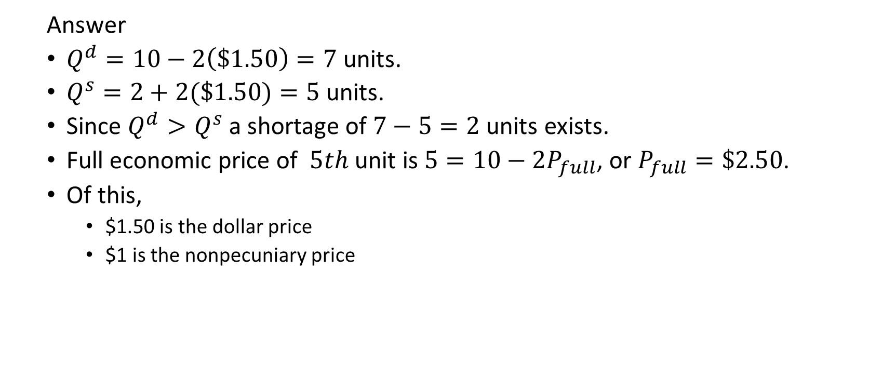
Price ceiling
Answer
$Q^{d}=10−2\left(\$1.50\right)=7$ units.
$Q^{s}=2+2(\$1.50)=5$ units.
Since $Q^{d}>Q^{s}$ a shortage of $7−5=2$ units exists.
Full economic price of $5th$ unit is $5=10−2P_{full}$, or $P_{full}=\$2.50$.
Of this,
$1.50 is the dollar price
$1 is the nonpecuniary price

Slide 39
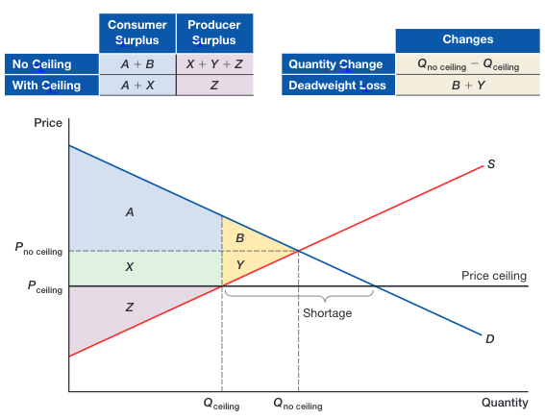
Dead weight loss

Slide 40
Simultaneous Shifts in Supply and Demand
Suppose that simultaneously the following two events occur:
worldwide demand for automobiles is projected to decrease by 30% next year.
war breaks out in a major oil-producing country in the Middle East.
What is the combined impact on the international crude oil market?

Slide 41
Simultaneous Shifts in Supply and Demand
International Oil Market
Price
(Dollars per Barrel)
Supply_{oil2}
Supply_{oil1}
$140
The equilibrium price increases
or decreases depending on the
magnitude of the demand
and supply changes.
P^{e1} = $80
P^{e2} = $65
$20
Demand_{oil2}
Demand_{oil1}
Q^{e2} = 10
Q^{e1} = 120
280

Slide 42
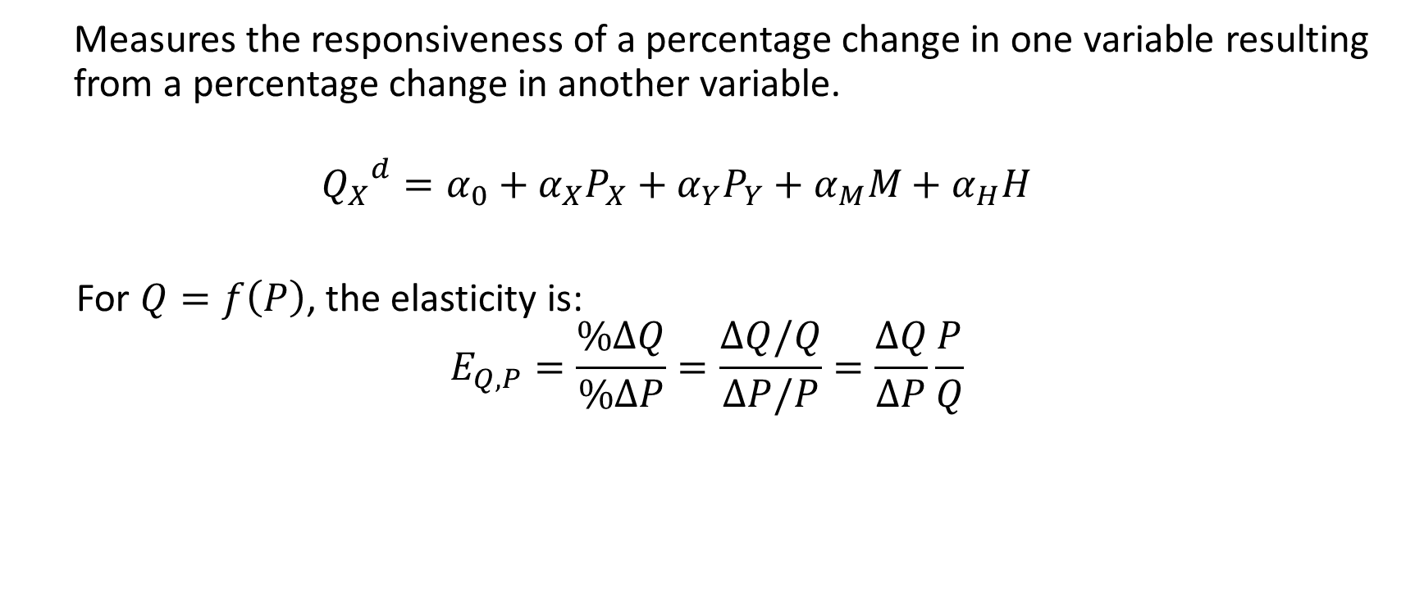
Elasticity
Measures the responsiveness of a percentage change in one variable resulting from a percentage change in another variable.
$${Q_{X}}^{d}=α_{0}+α_{X}P_{X}+α_{Y}P_{Y}+α_{M}M+α_{H}H$$
For $Q=f\left(P\right)$, the elasticity is:
$$E_{Q,P}=\frac{\%ΔQ}{\%ΔP}=\frac{ΔQ/Q}{ΔP/P}=\frac{ΔQ}{ΔP}\frac{P}{Q}$$

Slide 43
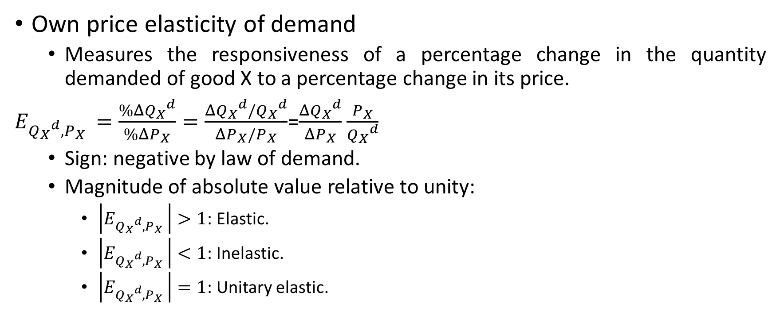
Own price elasticity
Own price elasticity of demand
Measures the responsiveness of a percentage change in the quantity demanded of good X to a percentage change in its price.
$E_{{Q_{X}}^{d},P_{X} }=\frac{\%Δ{Q_{X}}^{d}}{\%ΔP_{X}}=\frac{Δ{Q_{X}}^{d}/{Q_{X}}^{d}}{ΔP_{X}/P_{X}}$=$\frac{Δ{Q_{X}}^{d}}{ΔP_{X}}$ $\frac{P_{X}}{{Q_{X}}^{d}}$
Sign: negative by law of demand.
Magnitude of absolute value relative to unity:
$\left|E_{{Q_{X}}^{d},P_{X} }\right|>1$: Elastic.
$\left|E_{{Q_{X}}^{d},P_{X} }\right|<1$: Inelastic.
$\left|E_{{Q_{X}}^{d},P_{X} }\right|=1$: Unitary elastic.

Slide 44
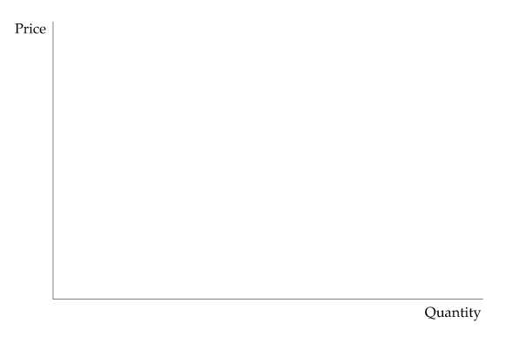
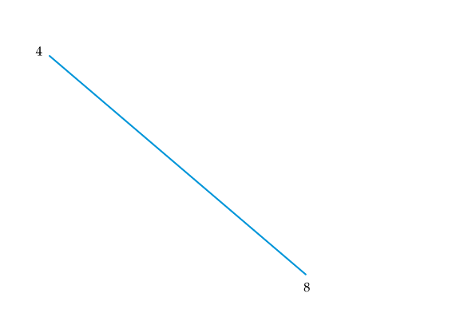
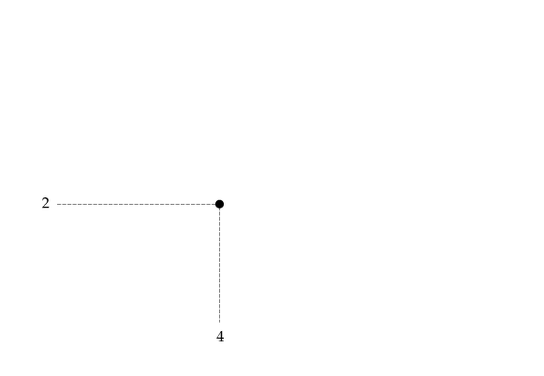
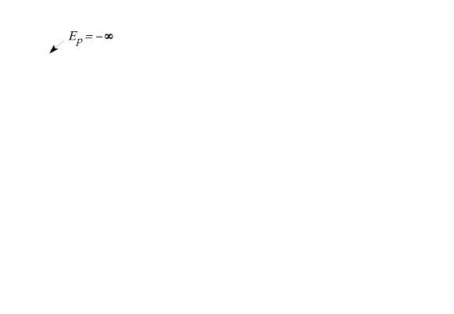
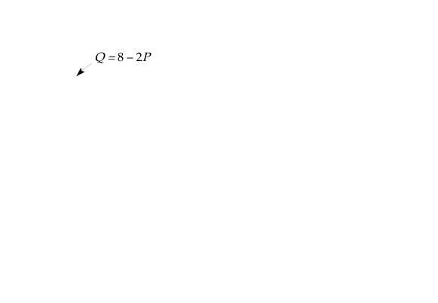
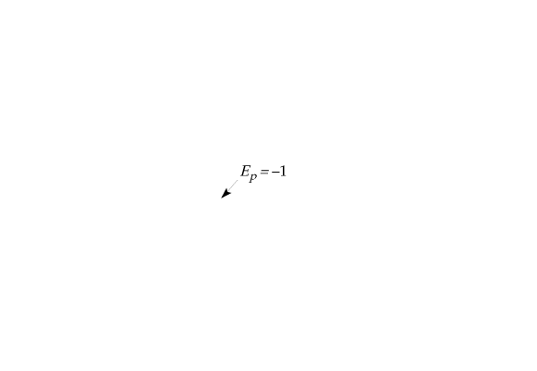
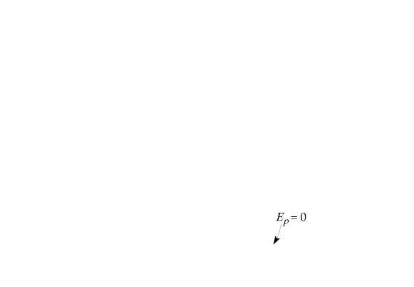
Own price elasticity on linear demand curve
linear demand curve Q = 8 – 2P
The price elasticity of demand depends not only on the slope of the demand curve but also on the price and quantity.
The elasticity, therefore, varies along the curve as price and quantity change. Slope is constant for this linear demand curve.
Near the top, because price is high and quantity is small, the elasticity is large in magnitude.
The elasticity becomes smaller as we move down the curve.

Slide 45

Elastic Demand Curve
Price
elastic
$$\left|E_{{Q_{X}}^{d},P_{X} }\right|>1$$
Quantity

Slide 46

Inelastic Demand Curve
Price
Inelastic
$$\left|E_{{Q_{X}}^{d},P_{X} }\right|<1$$
Quantity

Slide 47


Extreme Elasticities
Price
Demand
$$E_{{Q_{X}}^{d},P_{X} }=0$$
Perfectly
elastic
Demand
$$E_{{Q_{X}}^{d},P_{X} }=−∞$$
Perfectly Inelastic
Quantity

Slide 48

Elasticities of Demand & Supply
Consider a wheat market with demand and supply functions, respectively, as
$Q^{d}=3550−266P$ and $Q^{s}=1800+234P$
Determine the market-clearing price of wheat.
Determine price elasticities of demand and supply.

Slide 49
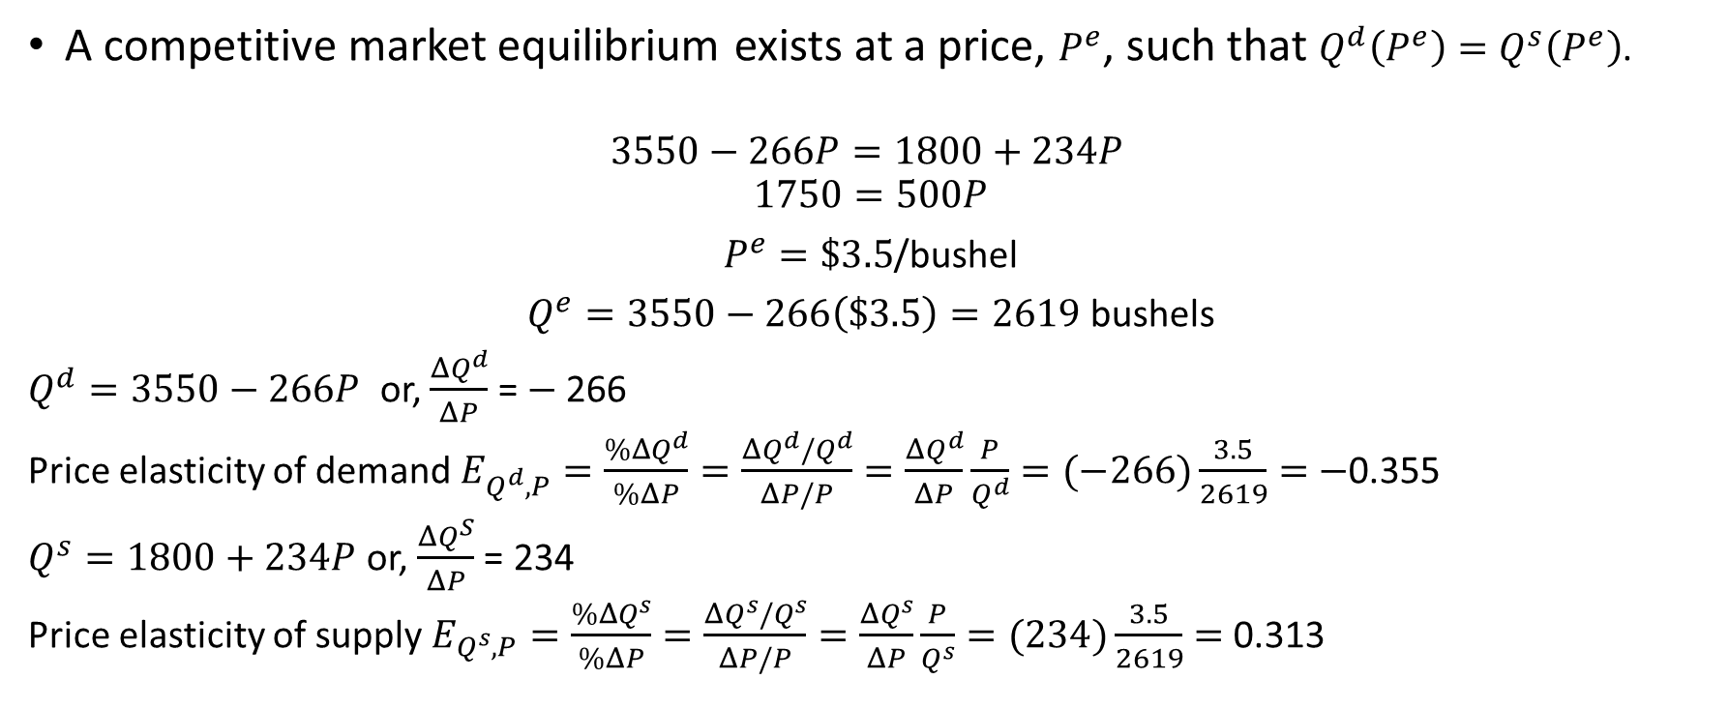
Elasticities of Demand & Supply
A competitive market equilibrium exists at a price, $P^{e}$, such that $Q^{d}\left(P^{e}\right)=Q^{s}\left(P^{e}\right)$.
$$3550−266P=1800+234P$$
$$1750=500P$$
$P^{e}=\$3.5$/bushel
$Q^{e}=3550−266\left(\$3.5\right)=2619$ bushels
$Q^{d}=3550−266P$ or, $\frac{ΔQ^{d}}{ΔP}$ = $−$266
Price elasticity of demand $E_{Q^{d},P}=\frac{\%ΔQ^{d}}{\%ΔP}=\frac{ΔQ^{d}/Q^{d}}{ΔP/P}=\frac{ΔQ^{d}}{ΔP}\frac{P}{Q^{d}}=(−266)\frac{3.5}{2619}=$ $−$0.355
$Q^{s}=1800+234P$ or, $\frac{ΔQ^{S}}{ΔP}$ = 234
Price elasticity of supply $E_{Q^{s},P}=\frac{\%ΔQ^{s}}{\%ΔP}=\frac{ΔQ^{s}/Q^{s}}{ΔP/P}=\frac{ΔQ^{s}}{ΔP}\frac{P}{Q^{s}}=(234)\frac{3.5}{2619}=$ 0.313

Slide 50
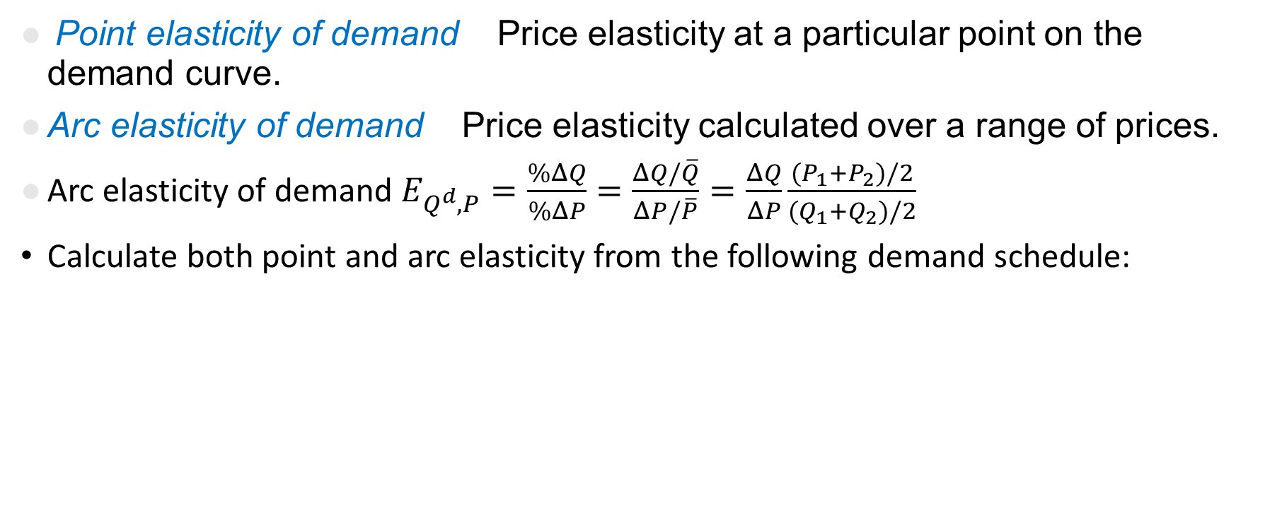
Point vs Arc Elasticities
Point elasticity of demand Price elasticity at a particular point on the demand curve.
Arc elasticity of demand Price elasticity calculated over a range of prices.
Arc elasticity of demand $E_{Q^{d},P}=\frac{\%ΔQ}{\%ΔP}=\frac{ΔQ/\overline{Q}}{ΔP/\overline{P}}=\frac{ΔQ}{ΔP}\frac{(P_{1}+P_{2})/2}{(Q_{1}+Q_{2})/2}$
Calculate both point and arc elasticity from the following demand schedule:
Price of tea (INR) | Quantity demanded (Kg.)
20 | 100
22 | 85

Slide 51
Short Run Vs Long Run Demand Curves
Diagrammatically explain the following
The demand for gasoline in the short run and long run.
The demand for automobile in the short run and long run.

Slide 52
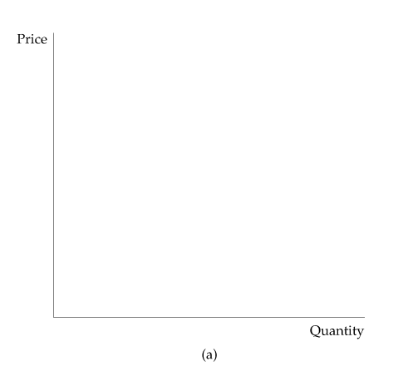
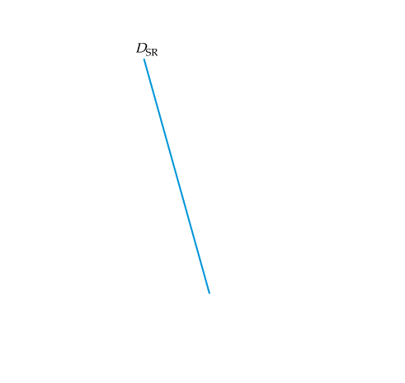
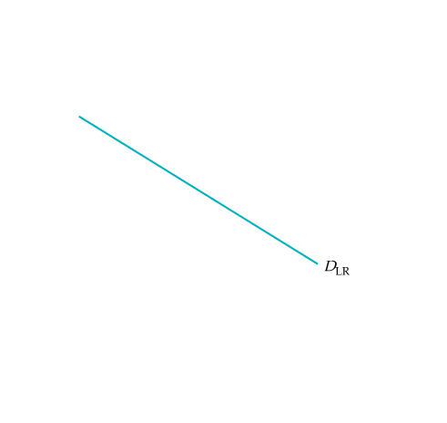
Gasoline: Short-Run and Long-Run Demand Curves

Slide 53
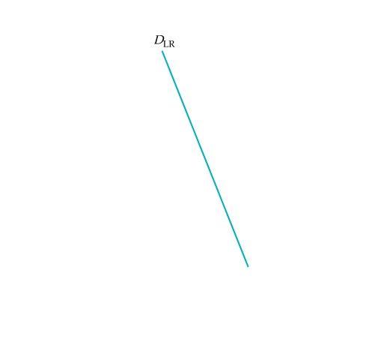
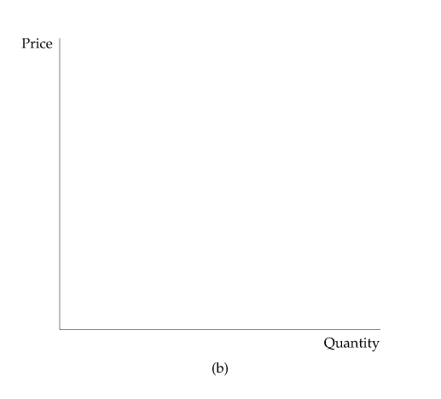
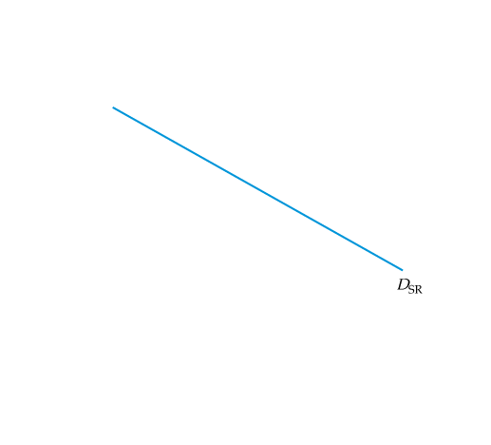
Automobile: Short-Run and Long-Run Demand Curves

Slide 54
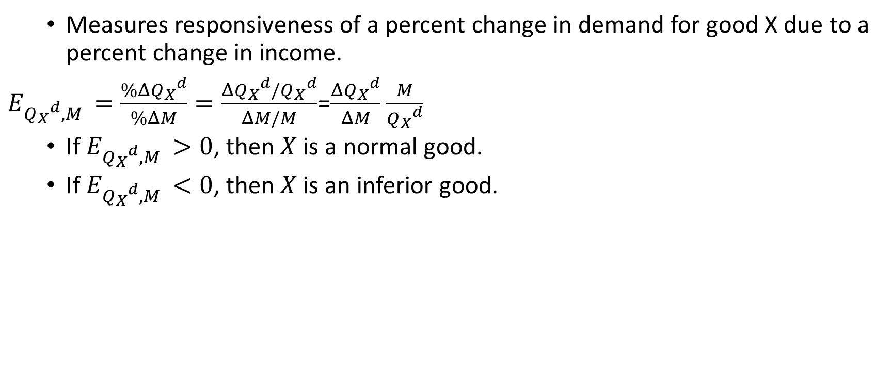
Income elasticity
Measures responsiveness of a percent change in demand for good X due to a percent change in income.
$E_{{Q_{X}}^{d},M }=\frac{\%Δ{Q_{X}}^{d}}{\%ΔM}=\frac{Δ{Q_{X}}^{d}/{Q_{X}}^{d}}{ΔM/M}$=$\frac{Δ{Q_{X}}^{d}}{ΔM}$ $\frac{M}{{Q_{X}}^{d}}$
If $E_{{Q_{X}}^{d},M }>0$, then $X$is a normal good.
If $E_{{Q_{X}}^{d},M }<0$, then $X$is an inferior good.

Slide 55
Income elasticity
Suppose that the income elasticity of demand for transportation is estimated to be 1.80. If income is projected to decrease by 15 %, what is the impact on the demand for transportation?
Is transportation a normal or inferior good?

Slide 56

Income elasticity
Answer
$$1.8=\frac{\%Δ{Q_{X}}^{d}}{−15}$$
Demand for transportation will decline by 27 percent.
Since demand decreases as income declines, transportation is a normal good.

Slide 57
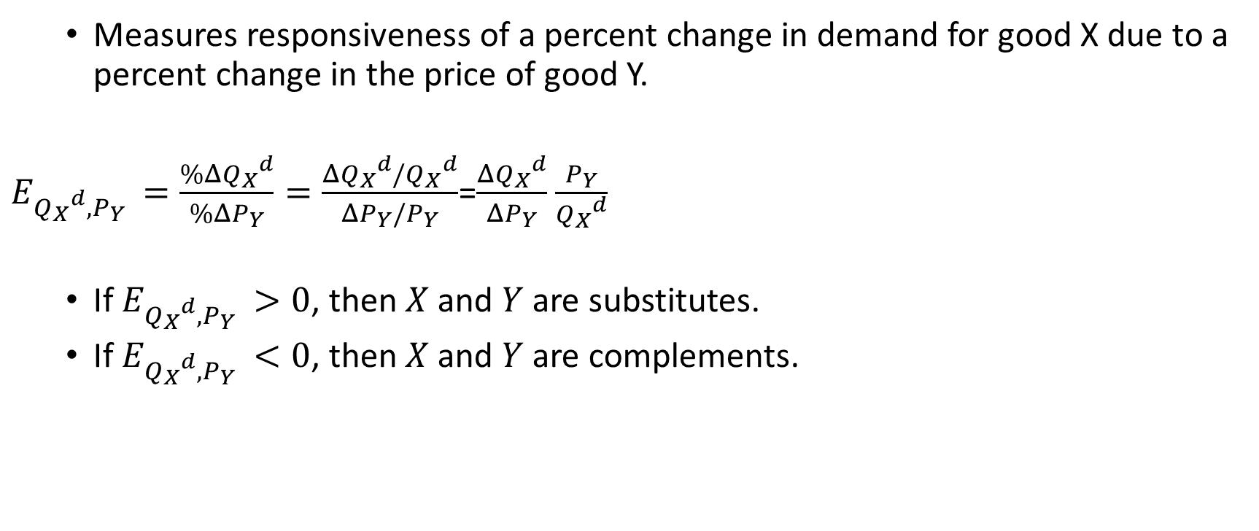
Cross-price elasticity
Measures responsiveness of a percent change in demand for good X due to a percent change in the price of good Y.
$E_{{Q_{X}}^{d},P_{Y} }=\frac{\%Δ{Q_{X}}^{d}}{\%ΔP_{Y}}=\frac{Δ{Q_{X}}^{d}/{Q_{X}}^{d}}{ΔP_{Y}/P_{Y}}$=$\frac{Δ{Q_{X}}^{d}}{ΔP_{Y}}$ $\frac{P_{Y}}{{Q_{X}}^{d}}$
If $E_{{Q_{X}}^{d},P_{Y} }>0$, then $X$and $Y$ are substitutes.
If $E_{{Q_{X}}^{d},P_{Y} }<0$, then $X$and $Y$ are complements.

Slide 58

Elasticities of Linear Demand Function
Given a linear demand function:
$${Q_{X}}^{d}=α_{0}+α_{X}P_{X}+α_{Y}P_{Y}+α_{M}M+α_{H}P_{H}$$
Own price elasticity: $α_{X}\frac{P_{X}}{{Q_{X}}^{d}}$.
Cross price elasticity: $α_{Y}\frac{P_{Y}}{{Q_{X}}^{d}}$.
Income elasticity: $α_{M}\frac{M}{{Q_{X}}^{d}}$.

Slide 59

Elasticities of Linear Demand Function
The daily demand for Invigorated PED shoes is estimated to be
$${Q_{X}}^{d}=100−3P_{X}+4P_{Y}−0.01M+2A_{X}$$
Suppose good X sells at $25 a pair, good Y sells at $35, the company utilizes 50 units of advertising, and average consumer income is $20,000. Calculate the own price, cross-price and income elasticities of demand.

Slide 60
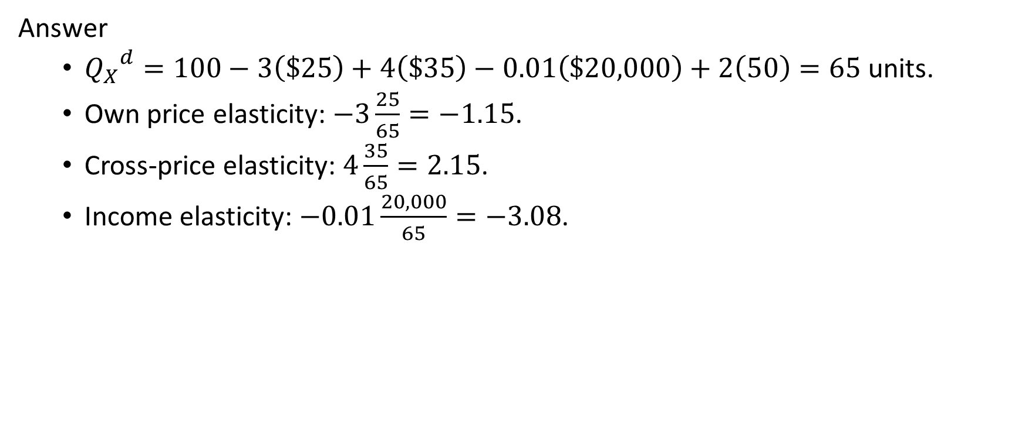
Elasticities of Linear Demand Function
Answer
${Q_{X}}^{d}=100−3\left(\$25\right)+4\left(\$35\right)−0.01\left(\$20,000\right)+2\left(50\right)=65$ units.
Own price elasticity: $−3\frac{25}{65}=−1.15$.
Cross-price elasticity: $4\frac{35}{65}=2.15$.
Income elasticity: $−0.01\frac{20,000}{65}=−3.08$.

Slide 61
Elasticities and Revenue
Calculate price elasticity of demand from the following demand schedules:
Price | Quantity Demanded | Revenue
20 | 100 | ?
22 | 85 | ?
Price | Quantity Demanded | Revenue
100 | 100 | ?
110 | 95 | ?

Slide 62
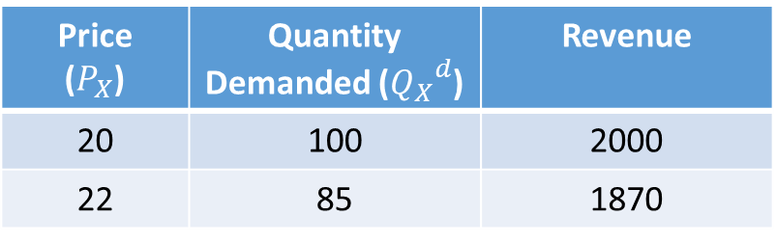



Elasticities and Revenue
Answer
$\left|E_{{Q_{X}}^{d},P_{X} }\right|=1.5>1$: Elastic
Price ($P_{X}$) | Quantity Demanded (${Q_{X}}^{d}$) | Revenue
20 | 100 | 2000
22 | 85 | 1870
Price ($P_{X}$) | Quantity Demanded (${Q_{X}}^{d}$) | Revenue
100 | 100 | 10000
110 | 95 | 10450
$\left|E_{{Q_{X}}^{d},P_{X} }\right|=0.5<1$: Inelastic

Slide 63
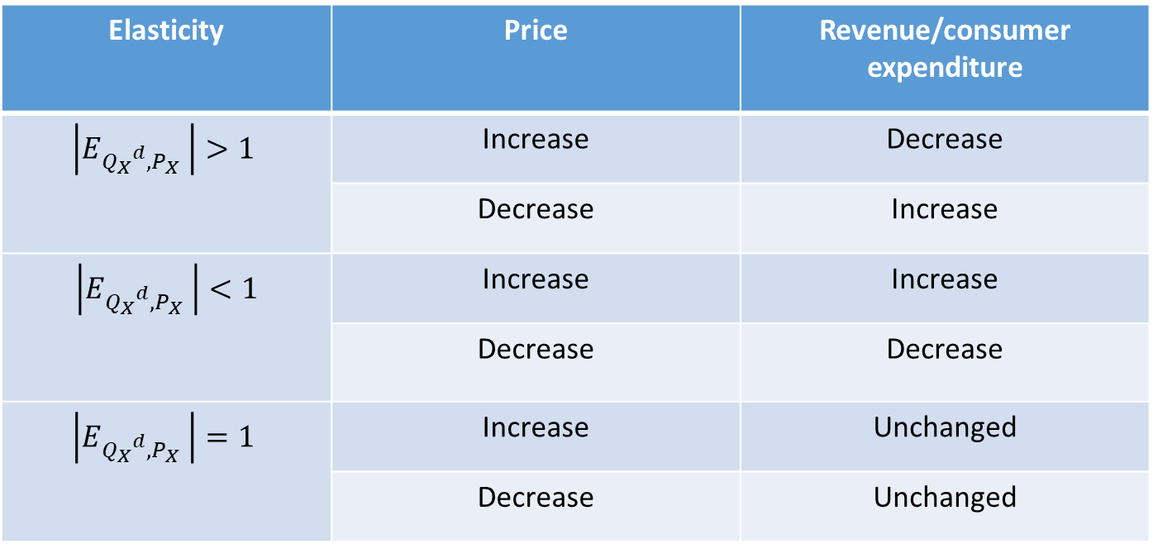
Elasticities and Revenue
Elasticity | Price | Revenue/consumer expenditure
$$\left|E_{{Q_{X}}^{d},P_{X} }\right|>1$$ | Increase | Decrease
 | Decrease | Increase
$$\left|E_{{Q_{X}}^{d},P_{X} }\right|<1$$ | Increase | Increase
 | Decrease | Decrease
$$\left|E_{{Q_{X}}^{d},P_{X} }\right|=1$$ | Increase | Unchanged
 | Decrease | Unchanged

Slide 64
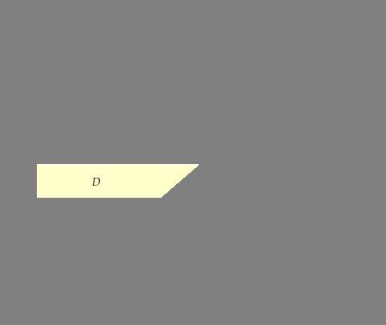

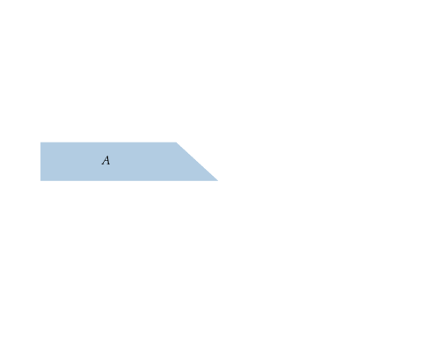
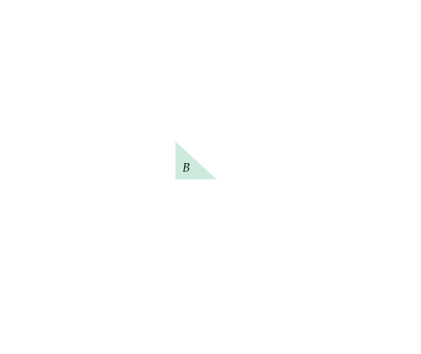









THE IMPACT OF A TAX
specific tax Tax of a certain amount of money per unit sold.
P_{b} is the price (including the tax) paid by buyers. P_{s} is the price that sellers receive, less the tax.
Here the burden of the tax is split evenly between buyers and sellers.
Buyers lose A + B.
Sellers lose D + C.
The government earns A + D in revenue.
The deadweight loss is B + C.
Market clearing requires four conditions to be satisfied after the tax is in place:
Q^{D} = Q^{D}(P_{b})
Q^{S} = Q^{S}(P_{s})
Q^{D} = Q^{S}
P_{b} − P_{s} = t

Slide 65
















THE IMPACT OF A TAX
Impact of a Tax Depends on Elasticities of Supply and Demand
(a) If demand is very inelastic relative to supply, the burden of the tax falls mostly on buyers.
(b) If demand is very elastic relative to supply, it falls mostly on sellers.

Slide 66
THE IMPACT OF A TAX: A NUMERICAL EXAMPLE
Assume there is a tax of $1 per unit on a FMCG good. The linear demand and supply curves are as follows:
Q^{D} = 150 – 25P_{b} (Demand)
Q^{S} = 60 + 20P_{s} (Supply)
(Calculate the government earning as tax revenue and deadweight loss.

Slide 67
THE IMPACT OF A TAX: A NUMERICAL EXAMPLE
Effect of a $1-per-unit tax:
Q^{D} = 150 – 25P_{b} (Demand)
Q^{S} = 60 + 20P_{s} (Supply)
Q^{D} = Q^{S} (Supply must equal demand)
P_{b} – P_{s} = 1.00 (Government must receive $1.00/unit)
150 − 25P_{b} = 60 + 20Ps
P_{b} = P_{s} + 1.00
150 − 25(P_{s} + 1) = 60 + 20P_{s}
20P_{s} + 25P_{s} = 150 – 25 – 60
45P_{s} = 65, or P_{s} = 1.44
Q = 150 – (25)(2.44) = 150 – 61, or Q = 89 million unit/yr
Annual revenue from the tax tQ = (1.00)(89) = $89 million per year
Deadweight loss: (1/2) x ($1.00/unit) x (11 million unit/year = $5.5 million per year

Slide 68
References
Baye, M. R. and Jeffrey T. Prince, J. T. (2014) Managerial Economics and Business Strategy. 8th Edition, McGrawHill Education (India) Private Limited, New Delhi
Pindyck, R.S. and Rubinfeld, D.L. (2017) Microeconomics, 8th Edition, Pearson Education, New Delhi

